Slide 1
Plant reproduction
IGCSE Biology
Wendy Chai

Slide 2
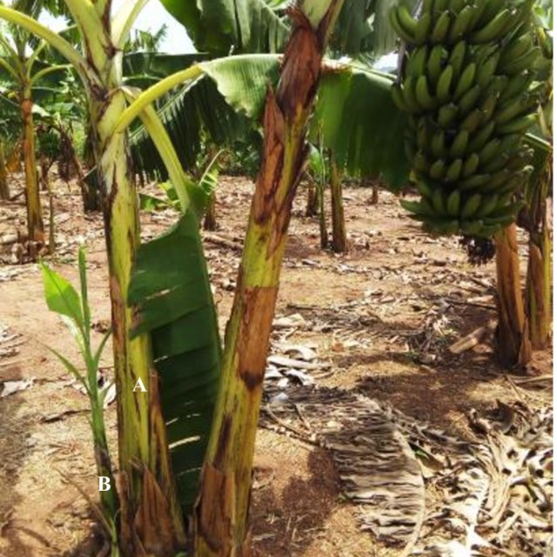
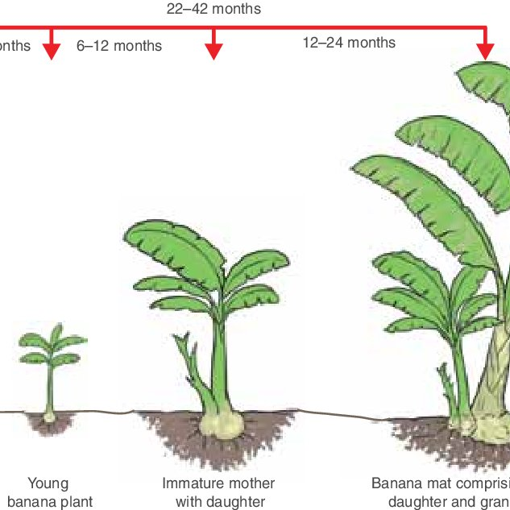
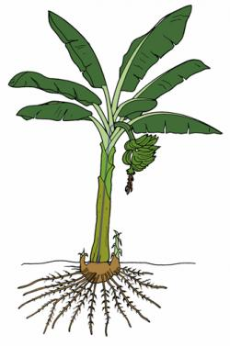
Sucker in banana
Suckers are shoots or small plants that develops from a lateral bud on the rhizome, arising from the base of a larger plant. (An example of asexual reproduction)
Notes:
A sucker is a shoot that develops from a lateral bud on the rhizome and emerges from the soil usually near the parent plant. It is a form of asexual, or vegetative, reproduction, that makes the banana plant perennial.

Slide 3
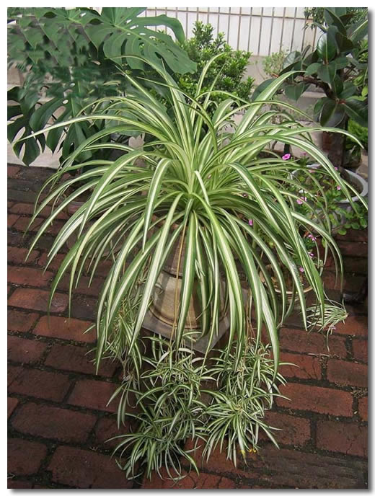
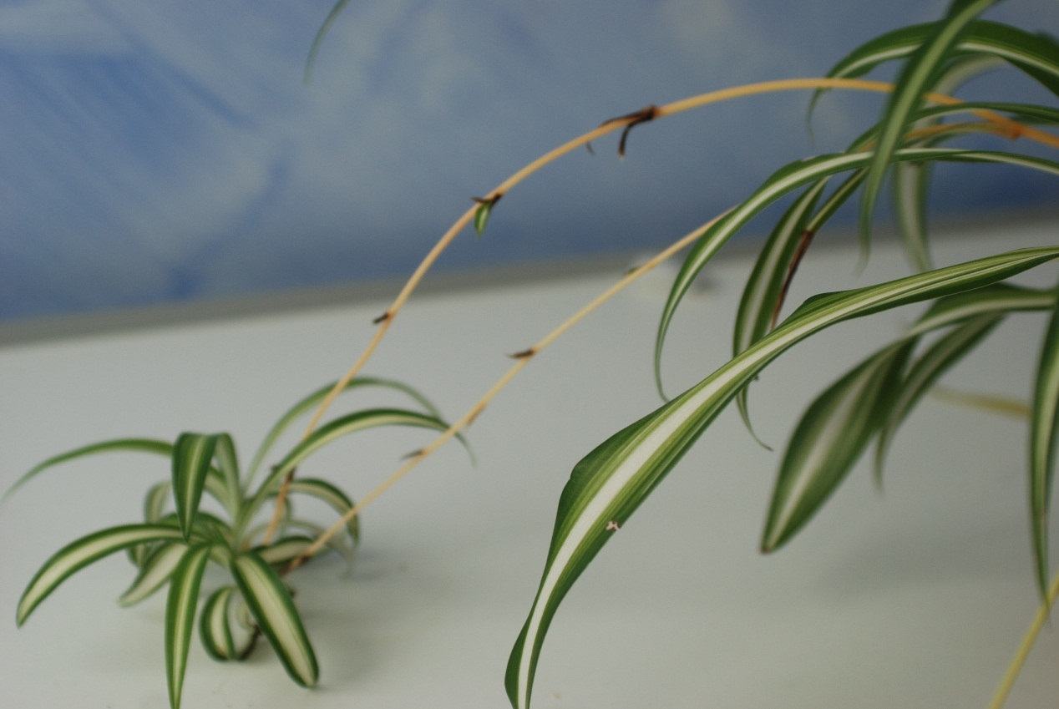
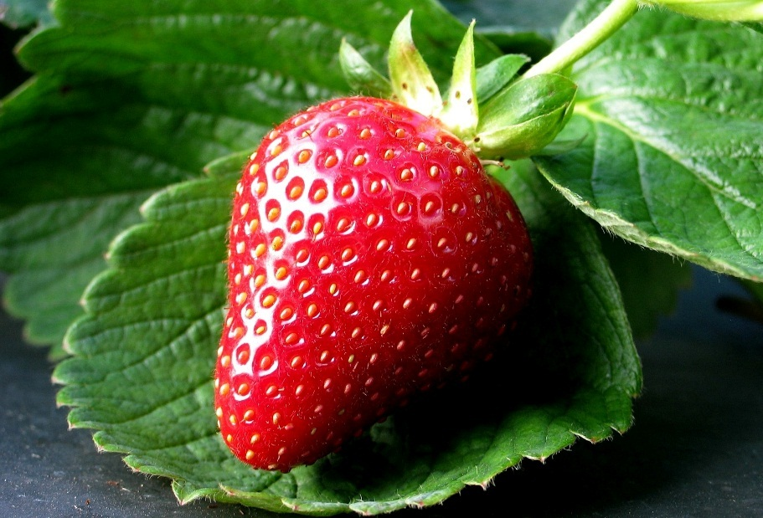
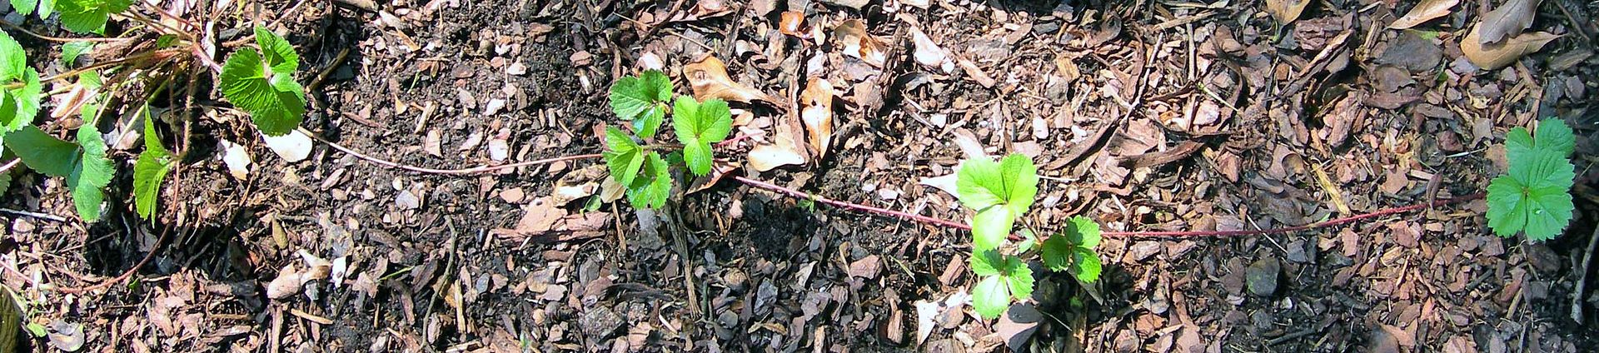
Asexual reproduction in plants
Spider plant
Stolon - stem

Slide 4
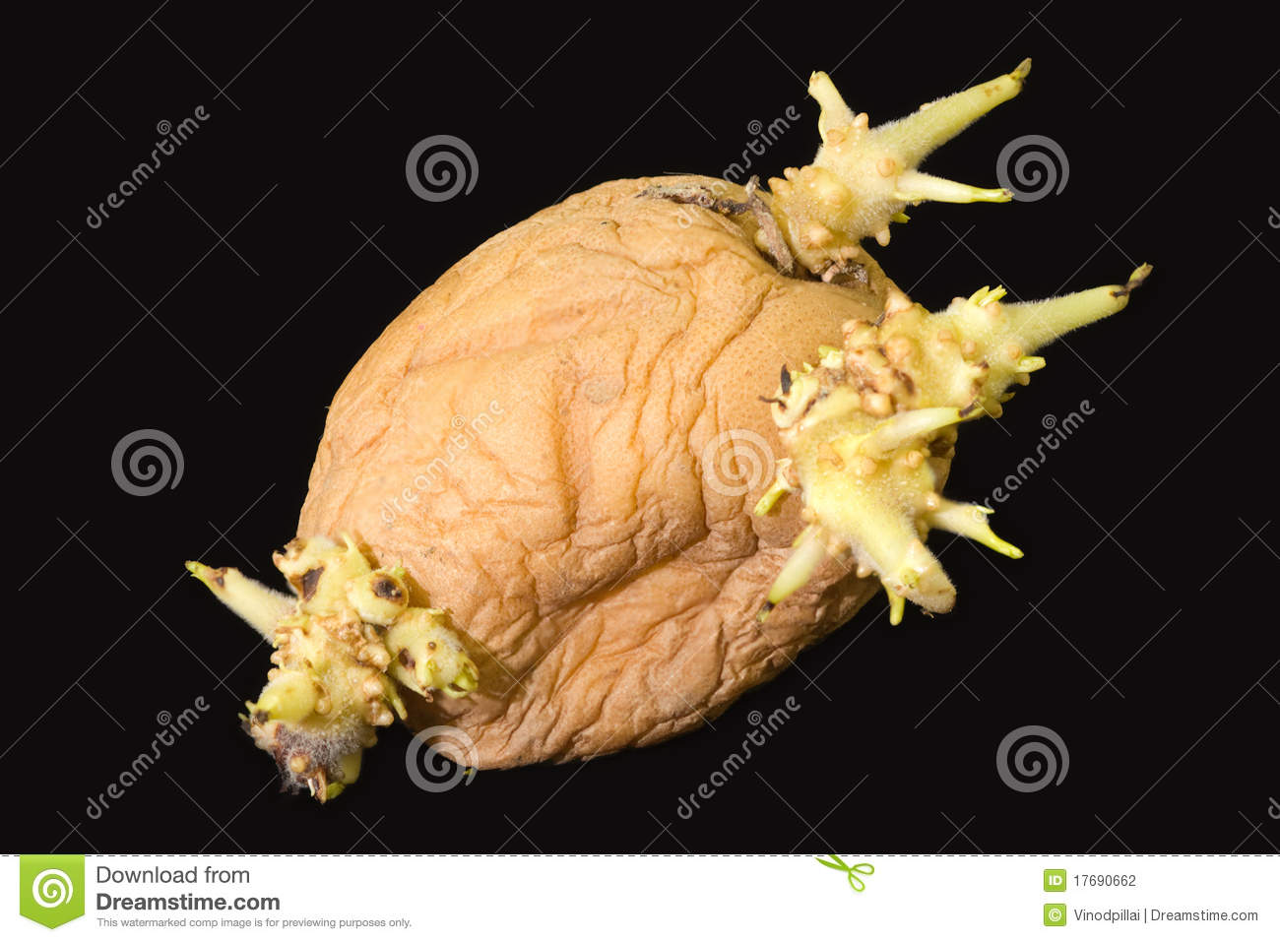
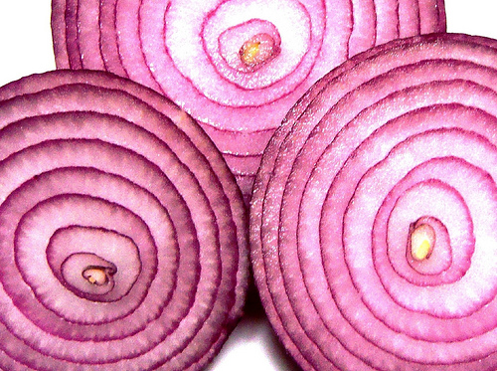
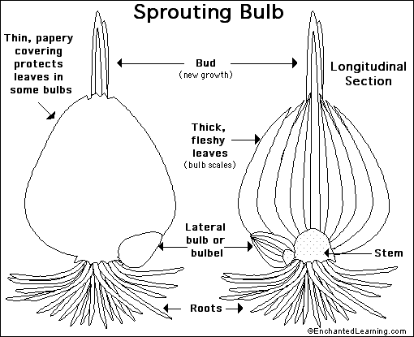
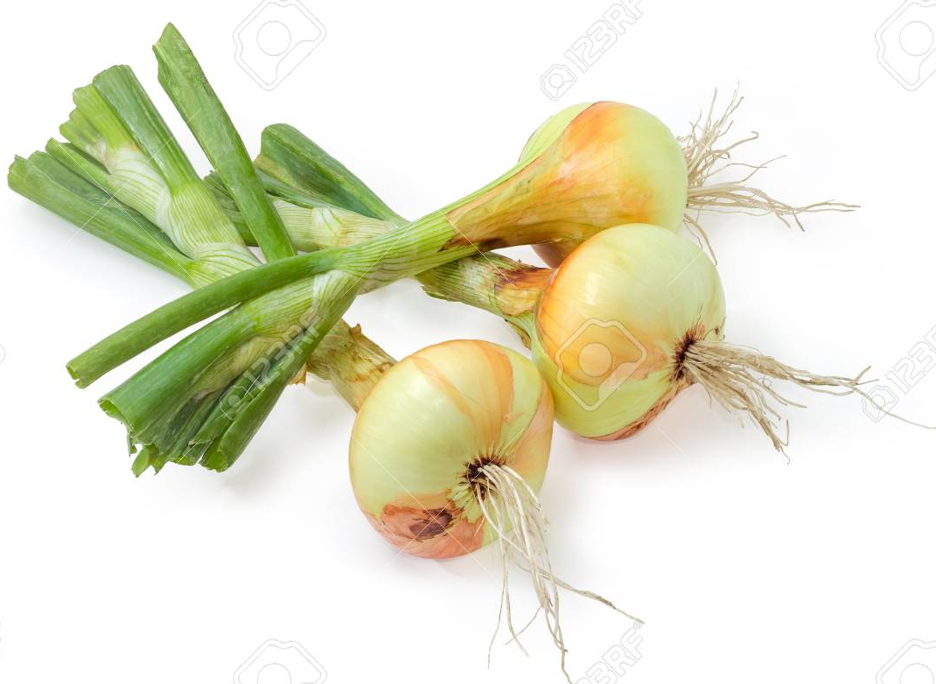
Potato tuber - stem
Onion bulb - stem

Slide 5
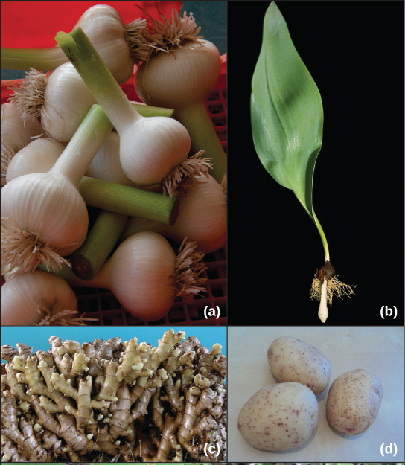

Asexual reproduction in plants
Different types of stems allow for asexual reproduction. (a) The corm of a garlic plant looks similar to (b) a tulip bulb, but the corm is solid tissue, while the bulb consists of layers of modified leaves that surround an underground stem. Both corms and bulbs can self-propagate, giving rise to new plants. (c) Ginger forms masses of underground stems called rhizomes that can give rise to multiple plants. (d) Potato plants form fleshy stem tubers. Each eye in the stem tuber can give rise to a new plant. (e) Strawberry plants form stolons: stems that grow at the soil surface or just below ground and can give rise to new plants.
Notes:
A stem tuber is a thickened part of a rhizome or stolon that has been enlarged for use as a storage organ.[4] In general, a tuber is high in starch, e.g. the potato, which is a modified stolon. The term "tuber" is often used imprecisely and is sometimes applied to plants with rhizomes. If a rhizome is separated each piece may be able to give rise to a new plant.
Plants with underground rhizomes include gingers, bamboo, lotus.
依据茎的演化状况的不同，变态茎可以分为地面下与地面上等两个类别。地面下的茎统称为地下茎，像是块茎、球茎、鳞茎与根状茎等都是属于此类。地面上的茎统称为地上茎，例如茎刺、叶状茎、肉质茎、攀缘茎等。

Slide 6
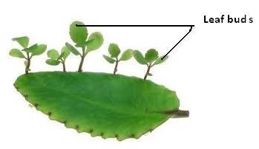
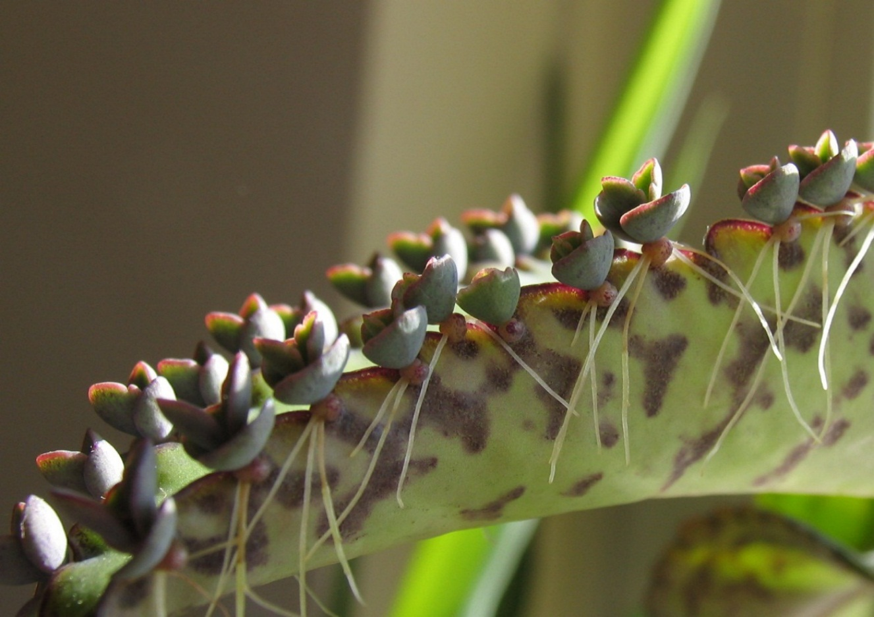
Asexual reproduction in plants
Bryophyllum - leaflets

Slide 7
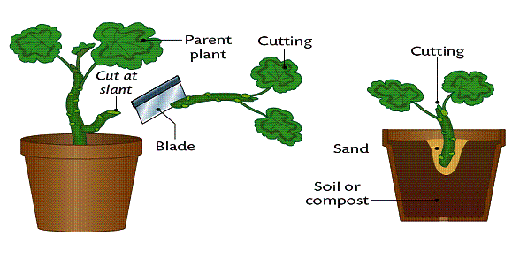
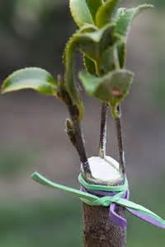
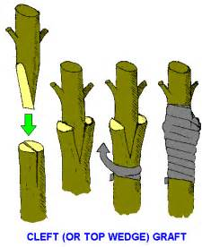
Artificial Propagation
a) cuttings
b) grafting

Slide 8
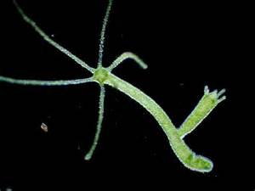
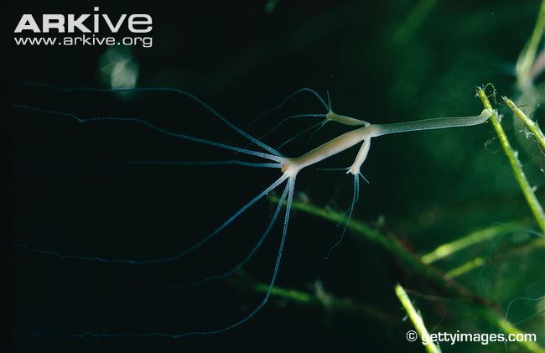
Asexual reproduction in hydra

Slide 9
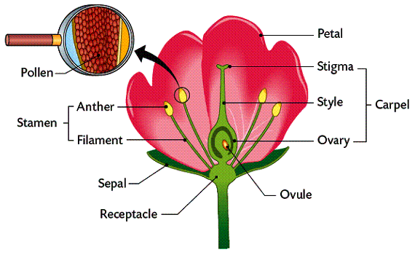
Parts of a flower

Slide 10
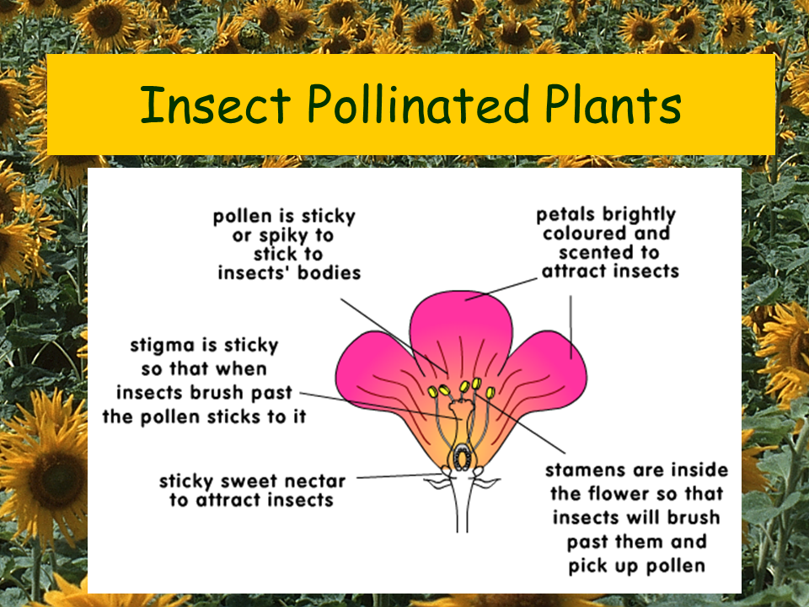

Slide 11
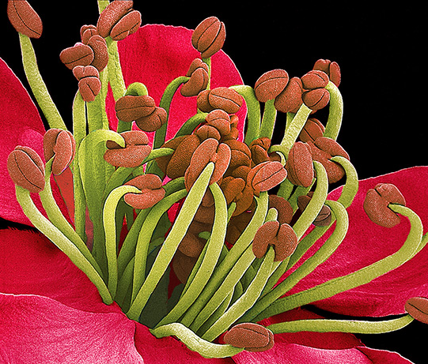
Stamen
Anther
Filament

Slide 12
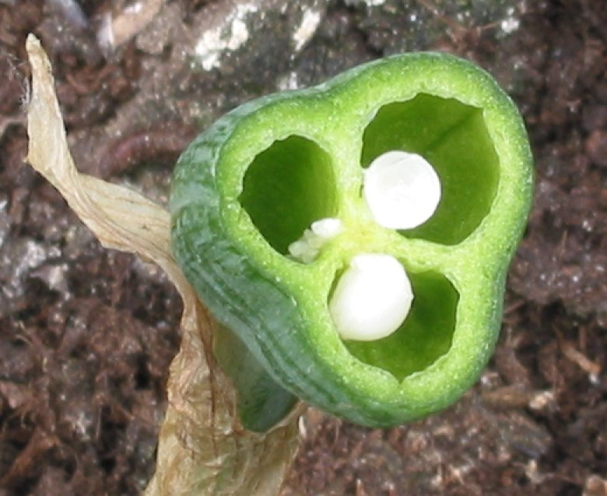
Pistil/ carpel
multiple carpels (a compound pistil) fused
Notes:
Depending on the number of carpels present, the pistil can be either simple or compound. When the pistil carries only one carpel, it is said to be a simple pistil, and when the pistil carries two or more, the pistil is said to be a compound pistil. Each carpel possesses three parts. Those are stigma, style and ovary.

Slide 13
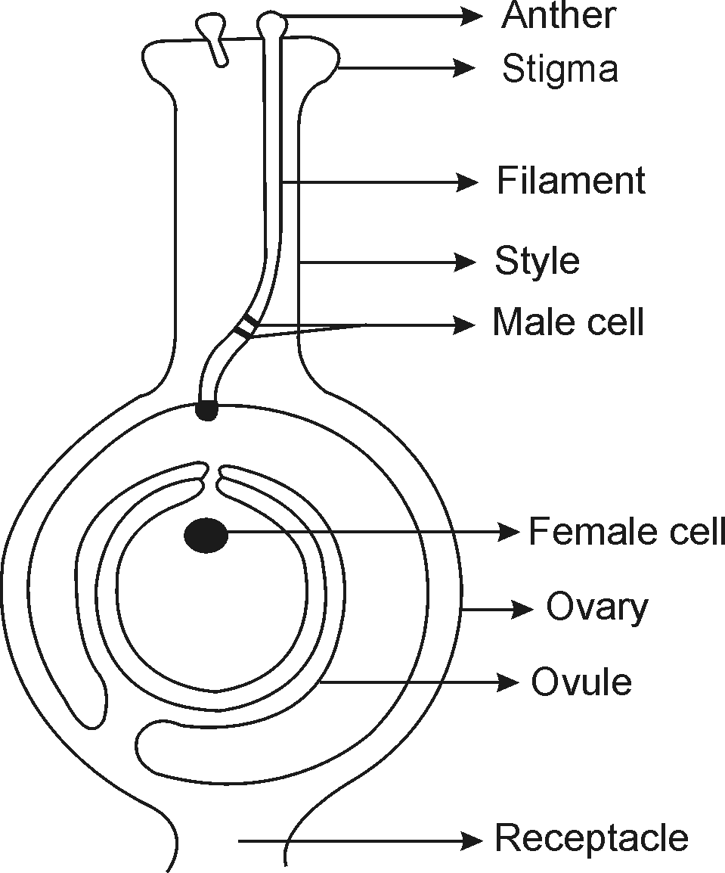
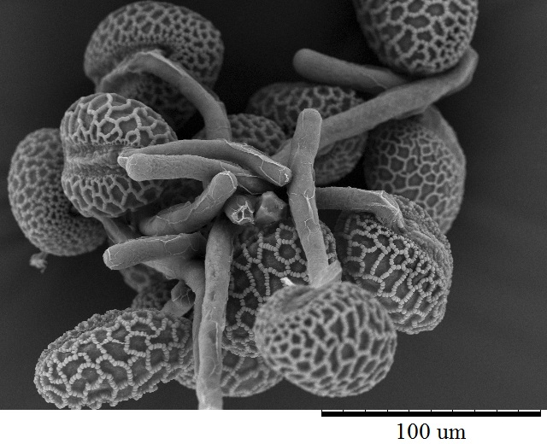
Fertilisation
Pollen grain
Stigma
Pollen tube
Style
Male cell
Lily pollen
Female cell/ ovum
Ovary
Ovule
Receptacle

Slide 14
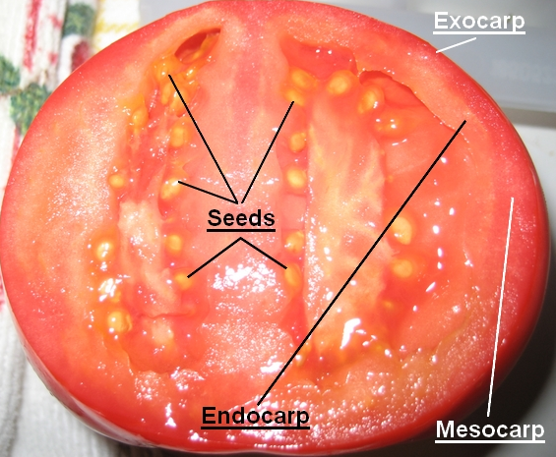
What happens to the different parts of a flower after fertilisation?

Slide 15
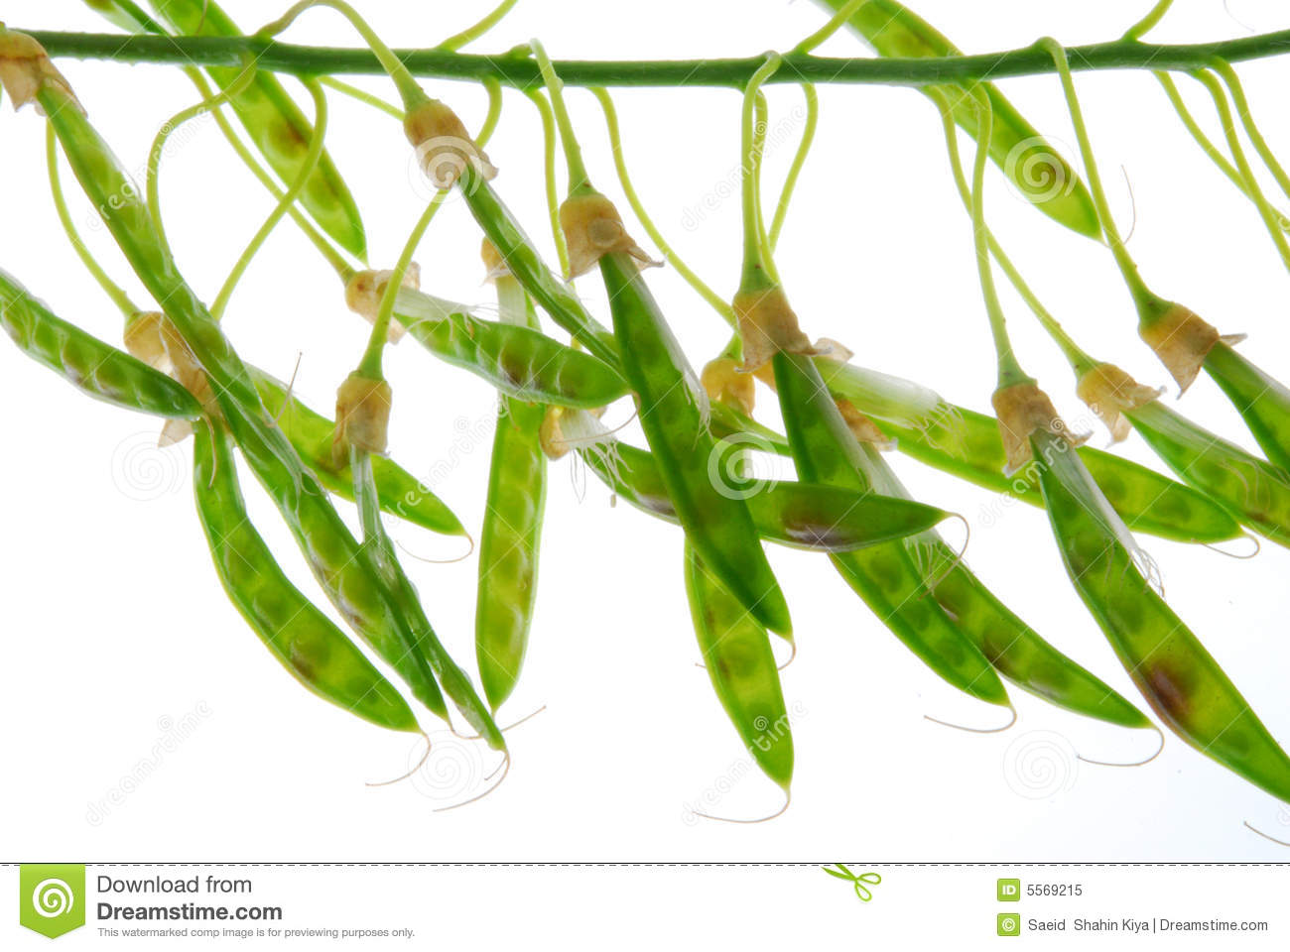
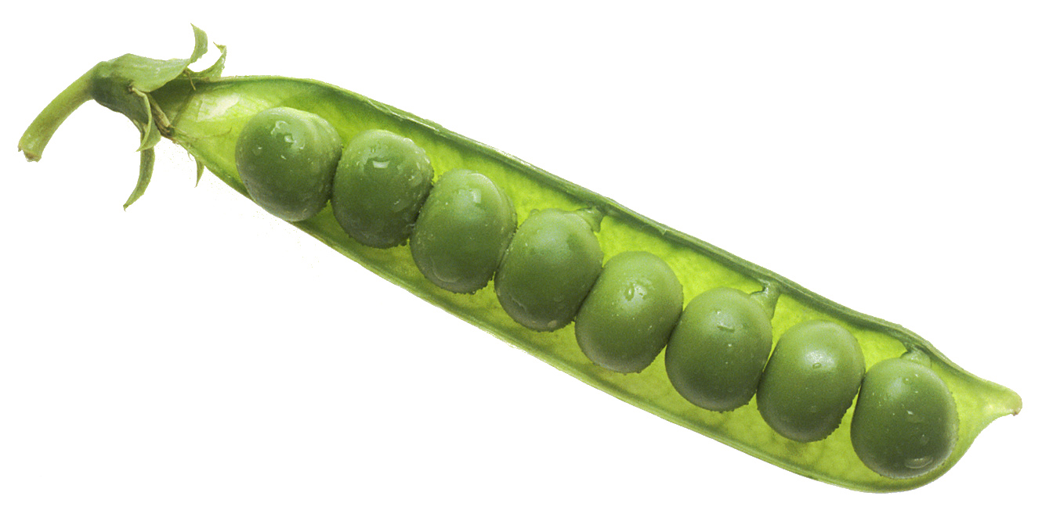

Slide 16
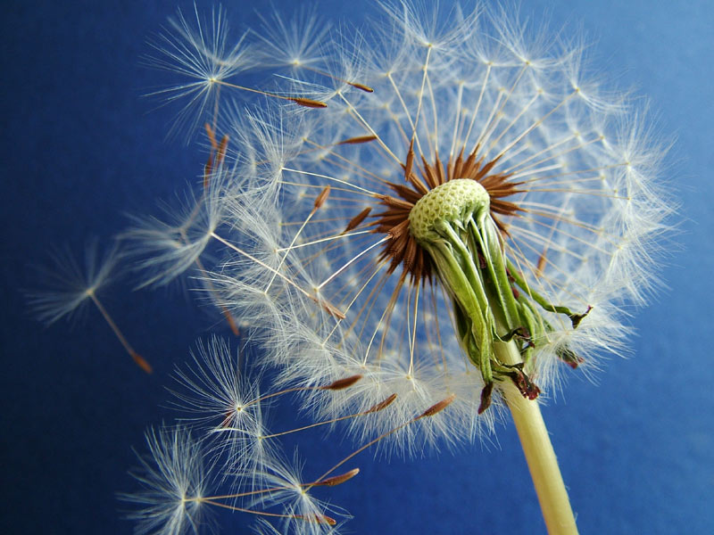
Seed dispersal
Seeds can be spread in four main ways.
Wind
Animals
Self dispersal/ ballistic
Water

Slide 17
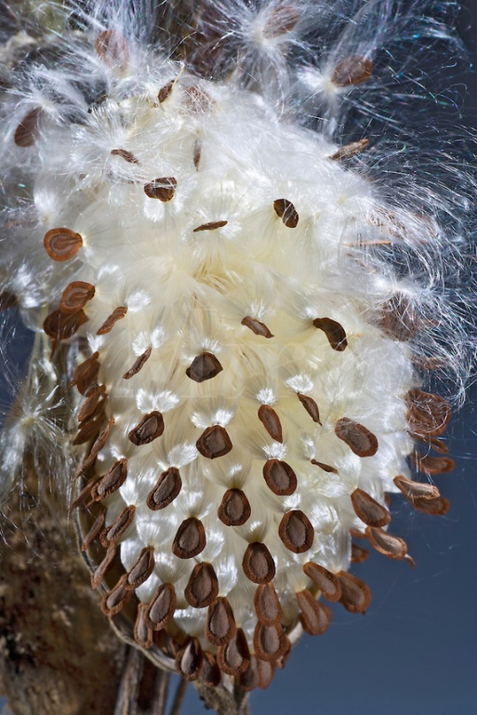
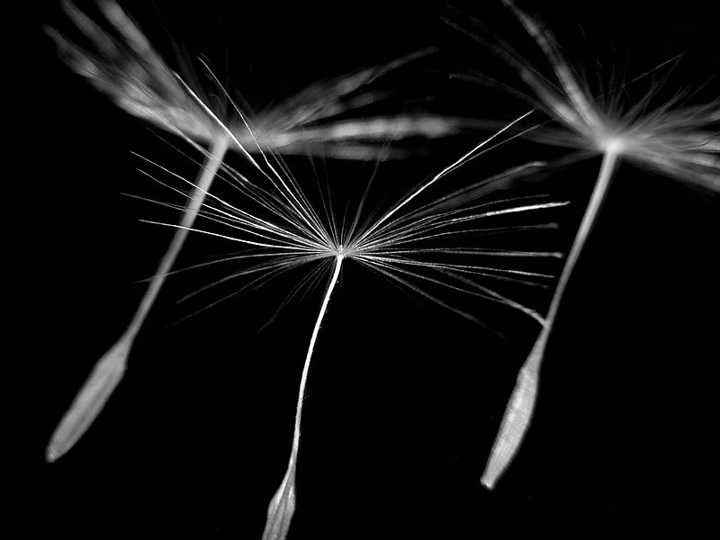
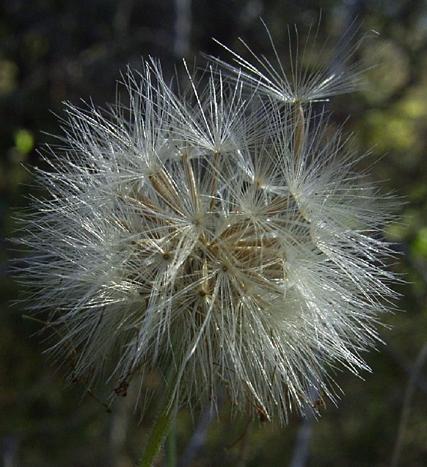
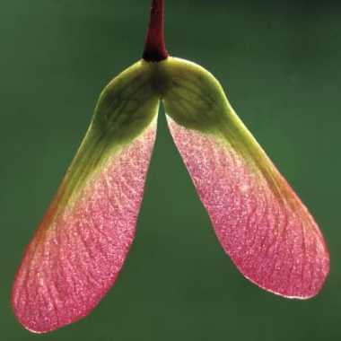
Wind
Milkweed
Dandelion
Maple

Slide 18
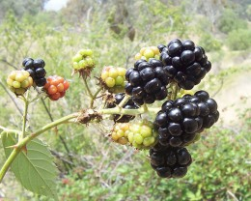
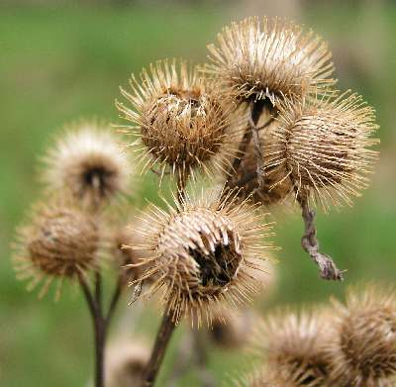
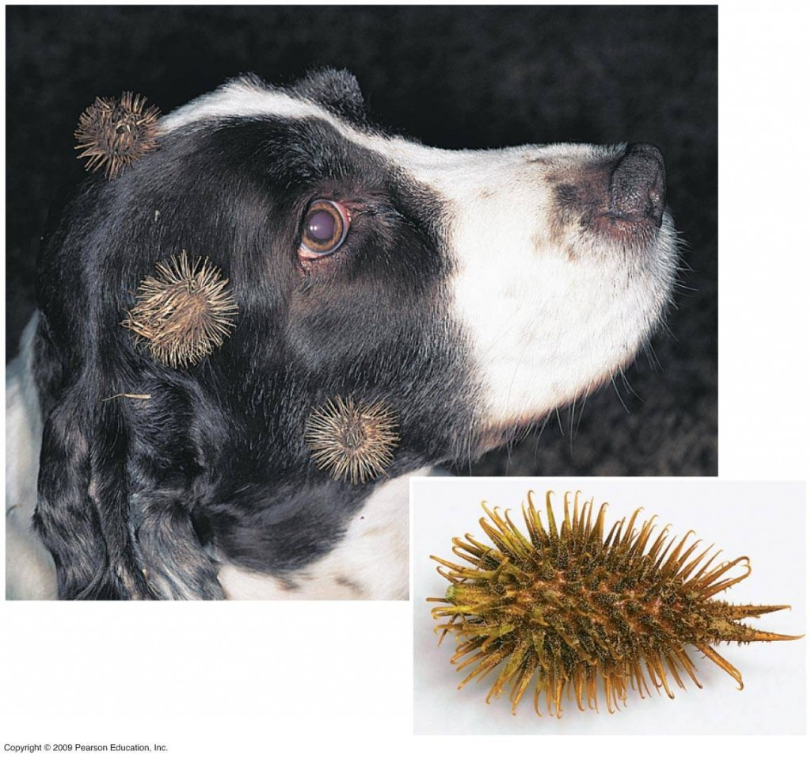
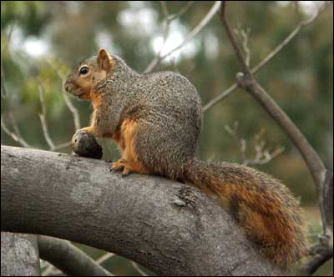
Animals
mulberry
Burdock
Acorns - Oak

Slide 19
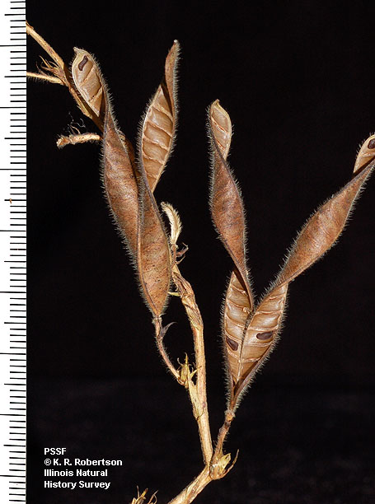
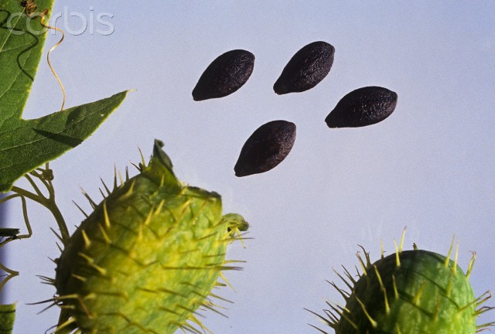
Self dispersal
Geranium
Squirting cucumber

Slide 20
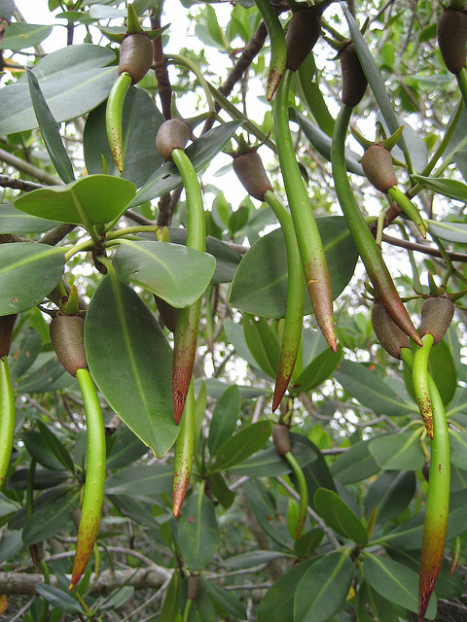
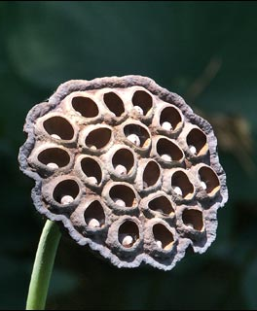
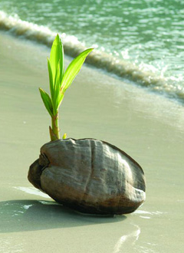
Water
Coconut
Lotus
Mangrove

Slide 21
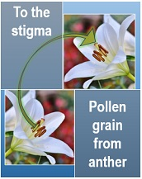
Pollination
The transfer of pollen grains from the anther to the stigma.
Self-pollination involves the transfer of pollen from the anthers to the stigma of the same flower or to a different flower on the same plant.
e.g. Some legumes, e.g. peanuts. Orchids, peas and sunflowers, wheat, barley, oats, rice, tomatoes, potatoes, apricots and peaches.
Cross-pollination involves the transfer of pollen from the anthers of one flower to the stigma of another flower on a different plant of the same species.
e.g. Insects: Apples, grapes, plums, pears, strawberries. Wind: grasses, catkins, dandelions, maple trees

Slide 22
Pollination
Many plants that are capable of self-pollinating can also be cross pollinated.
Self-pollination reduces the genetic diversity of plants in the same species, results in less variation (more uniform progeny/ offspring), meaning that the species is, for example, less resistant as a whole to disease.
But it is useful if there are no pollinating insects. So it does not need to expend energy on attracting pollinators and can spread beyond areas where suitable pollinators can be found.
Cross-pollination results in more variation/ diversity in species which is important in evolution/ natural selection.
However, it relies on the existence of pollinators that will travel from plant to plant.

Slide 23
Self-pollination V.S. Cross-pollination
Cause inbreeding (mating between closed related individuals, results in homozygosity which leads to inbreeding depression)
Cannot eliminate unwanted or harmful characters of plants, but preferred/ desirable traits can be conserved.
Usually have smaller flowers.
Self-pollination is economical to the plant.
Results in homozygous progenies (in long term).
Adaptability of progenies towards the changing environmental conditions is very less.
Plant yield will fall with time.
Causes outbreeding.
Can eliminate unwanted or harmful characters of plants.
Usually have brightly-colored petals, nectar and scent, or long stamens and pistils.
Cross-polination is not economical to the plant. To ensure cross pollination, the plant need to produce more flowers, pollen grains and nectar.
Results in heterozygous progenies (in long term).
Adaptability of progenies will be more due to the high variability.
Plant yield doesn’t fall with time.
https://www.easybiologyclass.com/difference-between-self-pollination-and-cross-pollination-comparison-table/
https://pediaa.com/difference-between-self-and-cross-pollination/

Slide 24
Pollination
Nature favor cross-pollination since, it enables a better chance for creating variability in the progenies.
Moreover, in order to prevent self-pollination, plants have evolved several structural and genetic methods such as
the production of unisexual flowers,
the positioning of male and female parts to avoid self-pollination,
self-incompatibility
and maturation of male and female parts in different types (protandry and protogyny)

Slide 25
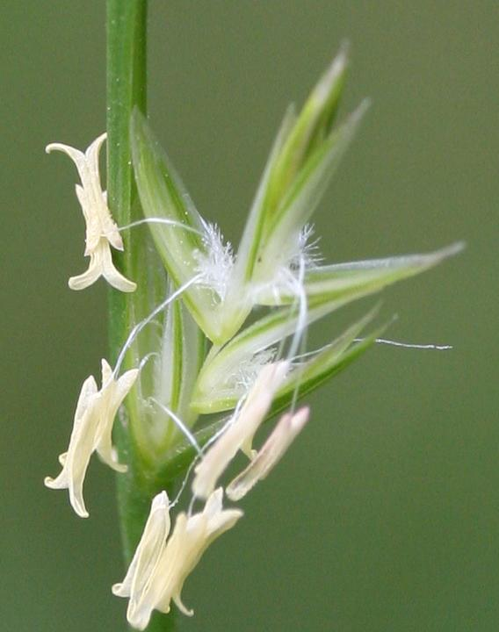
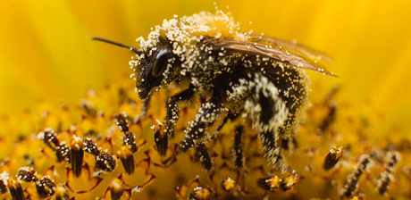
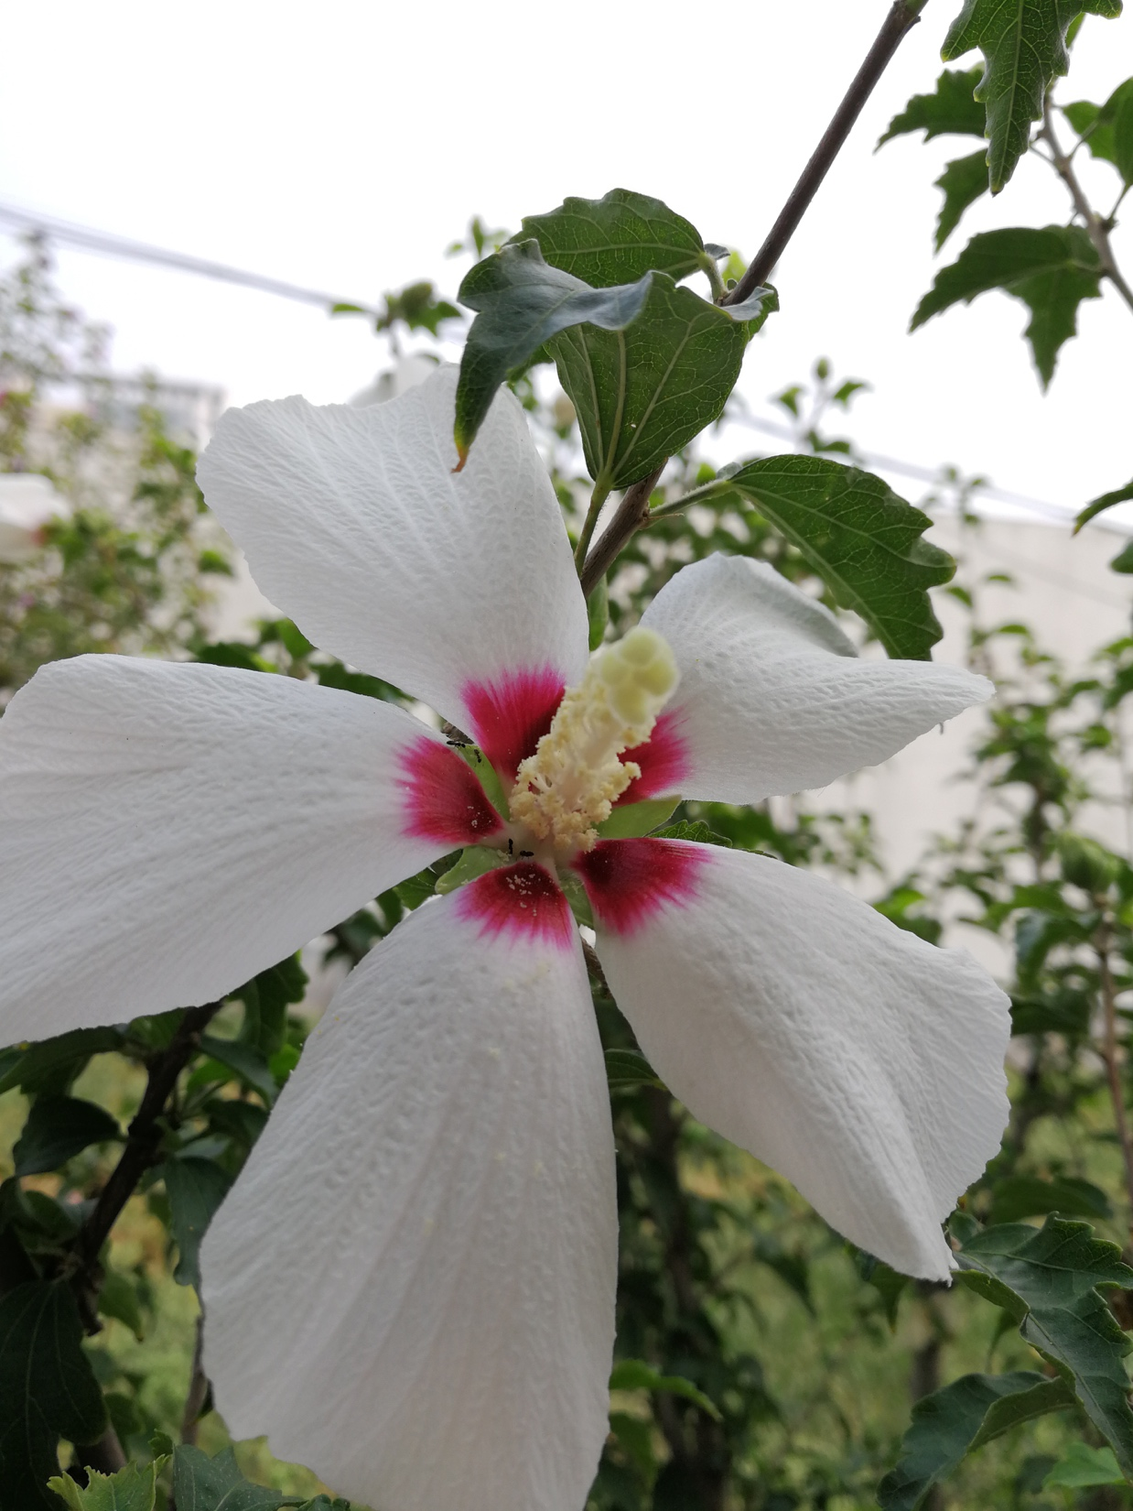
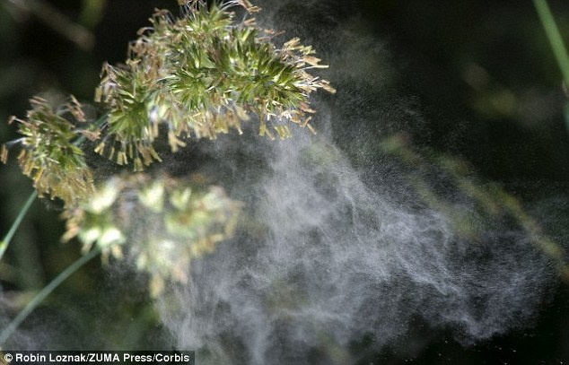
Adaptations to wind- & insect-pollination
Notes:
About 12% of the world’s flowering plants are wind-pollinated, including grasses and cereal crops, many trees

Slide 26
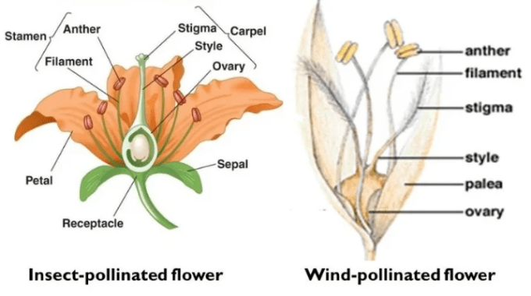

Slide 27
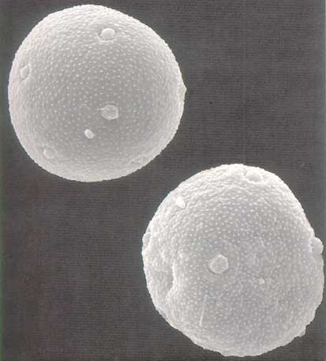
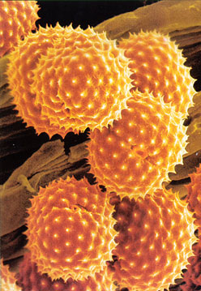
Pollen
Pollen from an insect-pollinated flower – note the spikes on the surface.
Grass pollen from a wind-pollinated flower - note the smooth surface.

Slide 28
Differences between insect and wind-pollinated flowers.
Feature | Insect-pollinated flowers | Wind-pollinated flowers
Petals | Present – colourful and scented to attract insects. | Absent or very small and difficult to see.
Nectaries | Present – make nectar, which is a sugary liquid food for pollinating insects. | Absent
Stamens | Present – usually with short filaments; anthers attached firmly to filaments; inside the flower for insects to rub against. | Long filaments so anthers hang outside the flower; anthers loosely attached to the filaments so pollen is easily blown away.
Pollen | Small amounts of sticky, spiky pollen grains that stick easily to insects’ bodies. | Large quantities of smooth, light pollen that can easily be carried in the wind.
Carpels | Sticky, small stigmas, usually inside the flower for insects to rub against. | Large, branched and feathery stigmas, outside the flower to catch pollen grains in the air.

